Slide 1
EDAP Digital assistant

Slide 2
Usage
Support
Development
File verification
Updating Jobs
Job failure analysis
Updating Triggers
Resubmitting failed jobs
Updating Dataset Definitions
Querying job execution status
Updating Schemas
Generating Dataset definitions from onboarding request form
Onboarding Datasets
Testing
Compare Data between source and target tables.
End User
Other Teams
Query data from Snowflake tables.
Actions under support

Slide 3



How ?
By Integrating the assistant with below key components
Catalog
APIs
Snowflake
Master database
To perform queries and actions
Target Data mart to query

Slide 4
Rasa Open source
What is Rasa?
The RASA Stack is a combination of open source libraries named RASA NLU and RASA Core that allow developers to expand chatbots and voice assistants rather than answering simple questions.
RASA NLU’s job is to interpret messages then RASA Core’s job is to decide what should happen next. It uses machine learning models to train conversations to decide what to do next.
Rasa Core determines which action to take from a predefined list.
An action is just a function such as displaying something, sending a message to the user etc. When an action is executed, it is passed a tracker instance, and so can make use of any relevant information collected over the history of the dialogue: slots and the results of previous actions.

Slide 5
How to do the integration?
Rasa action server to run custom actions
Officially Supported SDK : Python

Slide 6
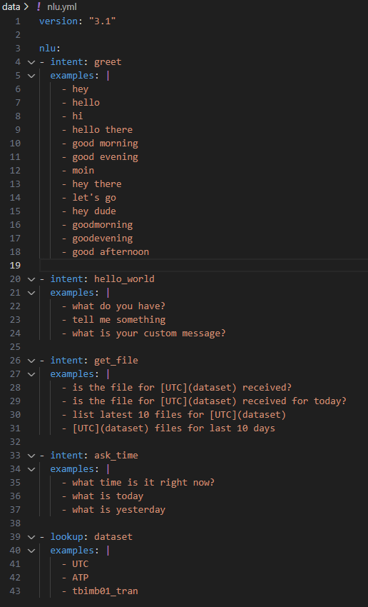
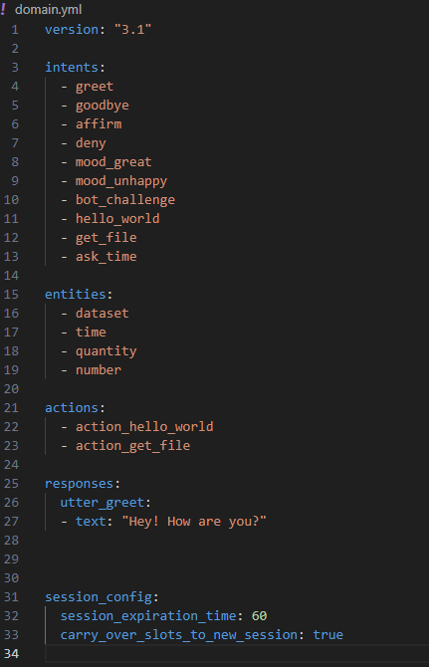
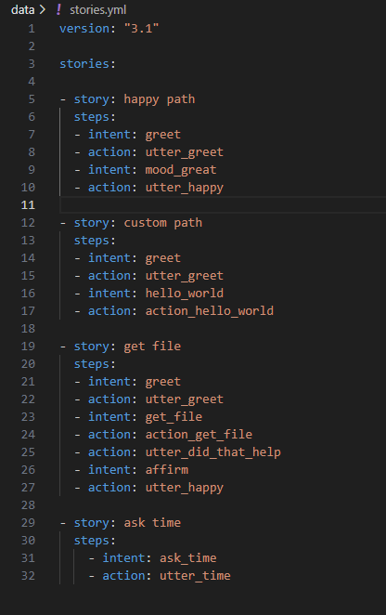
Rasa Control Files

Slide 7
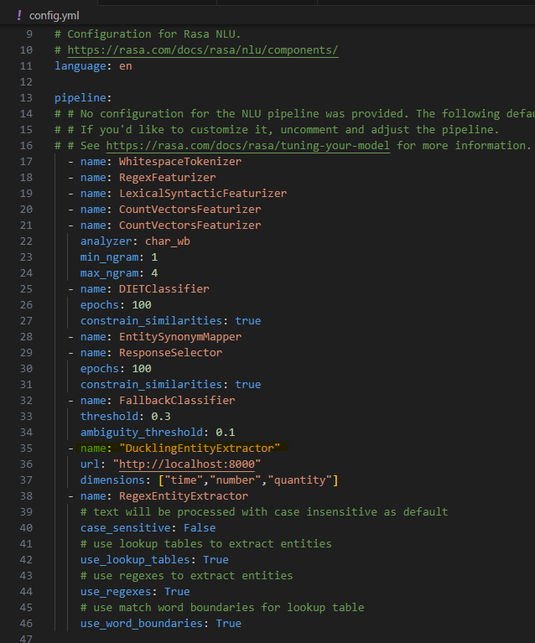
Rasa Config

Slide 8
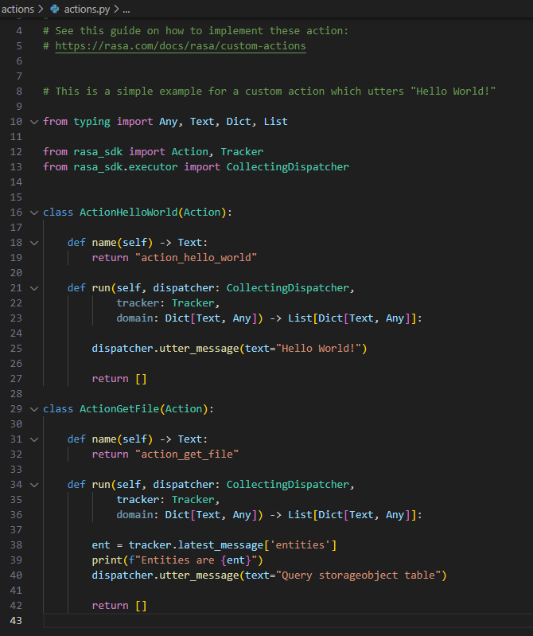
Rasa Custom Action

Slide 9
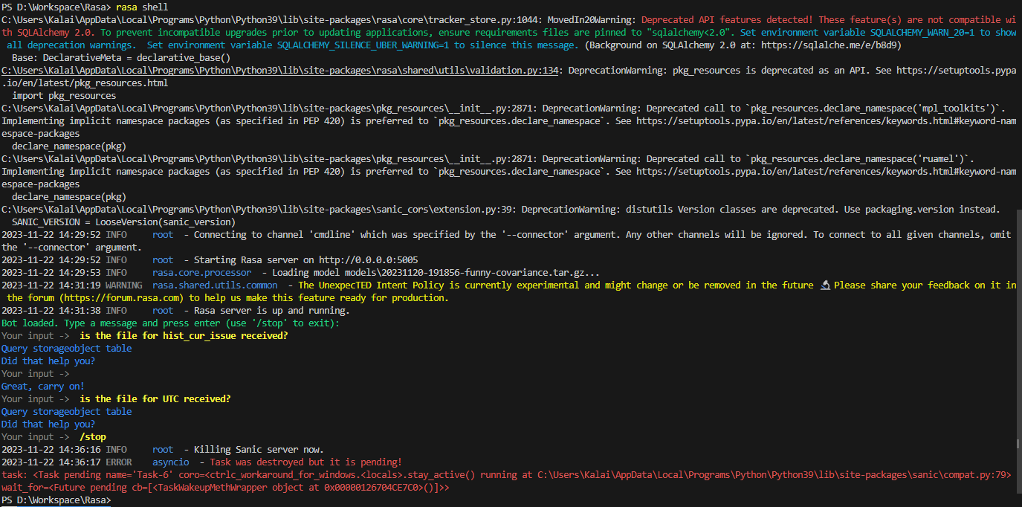
Rasa Shell

Slide 10
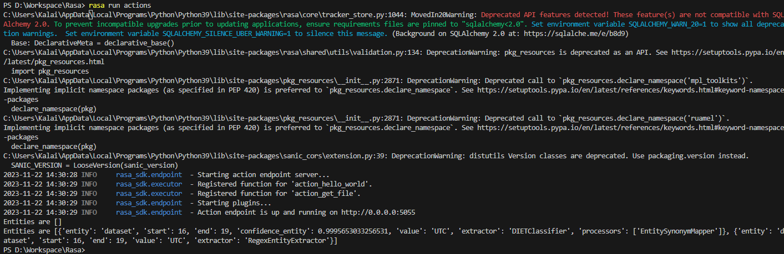
Rasa Action Server

Slide 11
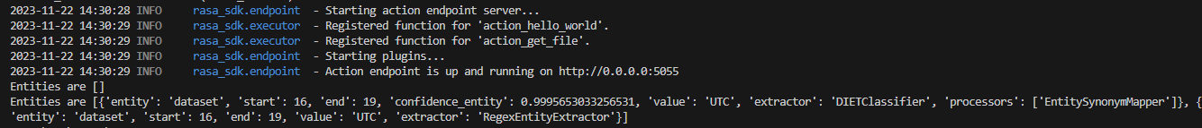
Rasa Entity extraction

Slide 12
Entity Extraction
Using DucklingEntityExtractor
Entities are [
{'entity': 'dataset', 'start': 16, 'end': 19, 'confidence_entity': 0.9996322393417358, 'value': 'UTC', 'extractor': 'DIETClassifier', 'processors': ['EntitySynonymMapper']
}, {'start': 29, 'end': 34, 'text': 'today', 'value': '2023-11-20T00:00:00.000-08:00', 'confidence': 1.0, 'additional_info': {'values': [{'value': '2023-11-20T00:00:00.000-08:00', 'grain': 'day', 'type': 'value'}], 'value': '2023-11-20T00:00:00.000-08:00', 'grain': 'day', 'type': 'value'}, 'entity': 'time', 'extractor': 'DucklingEntityExtractor'}]
Entities are [
{'entity': 'dataset', 'start': 0, 'end': 3, 'confidence_entity': 0.9993798732757568, 'value': 'UTC', 'extractor': 'DIETClassifier', 'processors': ['EntitySynonymMapper']}
, {'start': 14, 'end': 26, 'text': 'last 10 days', 'value': {'to': '2023-11-20T00:00:00.000-08:00', 'from': '2023-11-10T00:00:00.000-08:00'}, 'confidence': 1.0, 'additional_info': {'values': [{'to': {'value': '2023-11-20T00:00:00.000-08:00', 'grain': 'day'}, 'from': {'value': '2023-11-10T00:00:00.000-08:00', 'grain': 'day'}, 'type': 'interval'}], 'to': {'value': '2023-11-20T00:00:00.000-08:00', 'grain': 'day'}, 'from': {'value': '2023-11-10T00:00:00.000-08:00', 'grain': 'day'}, 'type': 'interval'}, 'entity': 'time', 'extractor': 'DucklingEntityExtractor'}]

